Slide 1
Test Scenario
Presented By
Afreen
Pooja
Radhika
Asfiya
Eesha

Slide 2
Test Scenario
A Test Scenario is a statement describing the functionality of the application to be tested. It is used for end-to-end testing of a feature and is generally derived from the use cases.
Test scenarios can serve as the basis for lower-level test case creation. A single test scenario can cover one or more test cases. Therefore a test scenario has a one-to-many relationship with the test cases.

Slide 3
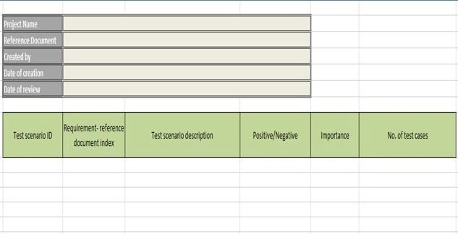
Template of test scenario

Slide 4
How to Write a Test Scenario?
Step 1: Read the Requirement Documents like BRS, SRS, FRS, of the System Under Test (SUT). We could also refer uses cases, books, manuals, etc. of the application to be tested.
Step 2: For each requirement, figure out possible users actions and objectives. Determine the technical aspects of the requirement.
Step 3: After reading the Requirements Document and doing your due Analysis, list out different test scenarios that verify each feature of the software.

Slide 5
Step 4: Once you have listed all possible Test Scenarios, a Traceability Matrix is created to verify that each & every requirement has a corresponding Test Scenario
Step 5: The scenarios created are reviewed by your supervisor. Later, they are also reviewed by other Stakeholders in the project.

Slide 6
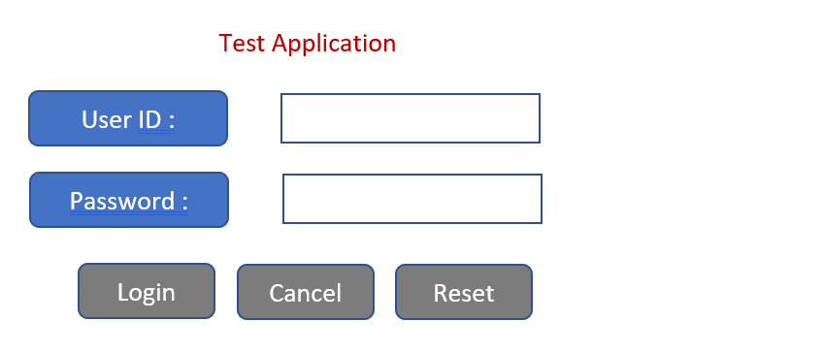
example for the Test Scenario
Here we can see Login, Reset and Cancel buttons on the page which will perform the respected functions when clicked.

Slide 7
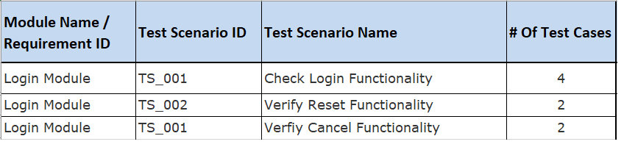
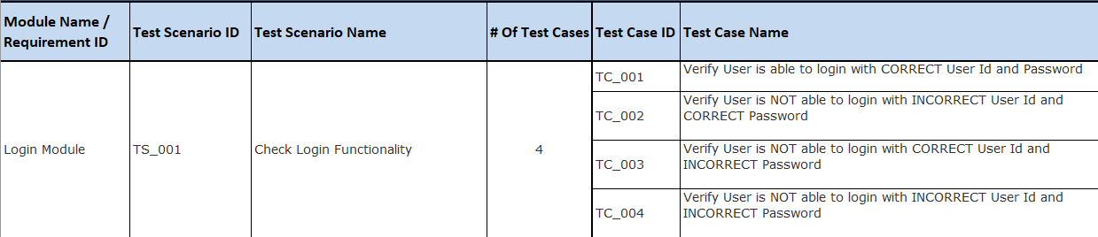
Here is the comparison between test scenario and test case

Slide 8
difference Between Test Scenario & Test Case
TEST CASE | TEST SCENARIO
Answer “How to Test” | Answer “What to Test”
Test case includes test case name, precondition, test steps, expected result, and the actual result | A test scenario is a high-level documentation which will be associated with multiple test cases
Execute a set of steps to validate the test scenario | Validate functionality of a software application
Hard to maintain due to more in numbers | Easy to maintain due to its high-level design
Derived from Test Scenarios | Derived from Use Cases or requirement documents like BRD, SRS
Written by Testers | Written by Test Leads, BAs or Testers

Slide 9
Best practice for writing test scenario
Should be easy to understand
Easily executable
Should be accurate
Traceable or mapped with the requirements
Should not have any ambiguity

Slide 10
Advantages
Scenario testing can be carried out relatively faster than testing using test cases.
It can ensure good test coverage since the test scenarios are derived from user stories.
It saves a lot of time. Hence, these are better with projects having time constraints.

Slide 11


